Slide 1
2024 Election – super Tuesday outcomes “Super Tuesday and election” For : DATA607 – Project 3 March 18, 2024

Slide 2
AGENDA
What and Why: Why this topic and what are our goals
How: Data gathering, transformation, analyses
What they say
Lesson learned

Slide 3
The power of prediction <- What and Why
What
Variety of data for cross-checking: Super Tuesday matters for the outcome of the election and rich data is available
Voter Insight: It reflects the voter behavior and campaign effectiveness
Pattern discovery: Uncover patterns that reveal the electorate’s pulse and the resonating impact of political messaging.
Why:
Voter Turnout: a window to voter’s behaviors
Demographics and how people vote, what resonates with voters, and patterns matters
Data could be used for predictive model (Future work)
Our Goals and Hypothesis:
Data Management: Streamline the collection, cleaning, and organization of data;
Insightful Reporting: Generate detailed statistical summaries and visualizations;
Strategy Assessment: campaign effectiveness by analyzing voter turnout data.
Present summary statistics, and present usefult graphs that eventually can be used for a predictive model
Hypothesis to explore: Hypothesis 1: The issue of abortion does not critically sway the election results; Hypothesis 2: For independent voters, the presidential candidate’s age is secondary to their position on abortion.
Notes:
Why we chose this topic, what question we wanted to answer, what we expected to get done, and why it is important (hypothesis and goals)
Your data science project on Super Tuesday is a fascinating choice! Here are some recommendations and help for answering your questions:
Topic Choice: Super Tuesday is a key event in the U.S. political process, offering rich data for analysis. It reflects voter behavior and the effectiveness of political campaigns, making it a valuable study subject.
Key Questions: You might explore which factors influence voter turnout, how demographics affect voting patterns, or the impact of media coverage on election results.
Expected Outcomes: Your team could aim to create predictive models, analyze voter sentiment, or identify key indicators of electoral success.
Importance: Understanding these elements can provide insights into democratic processes and inform future political strategies. Your hypothesis might focus on the predictive power of certain variables, with goals to enhance the accuracy of election forecasting.

Slide 4
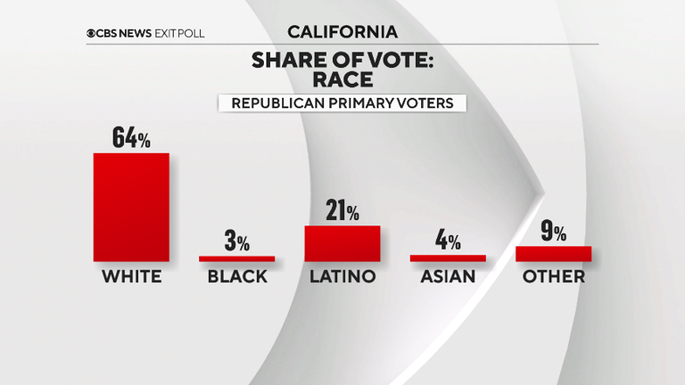
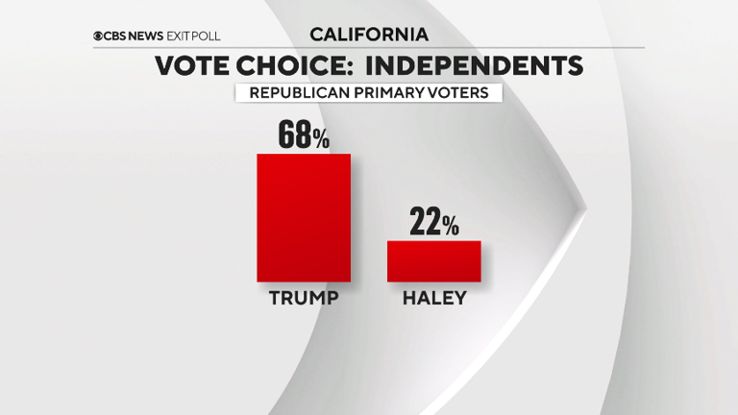
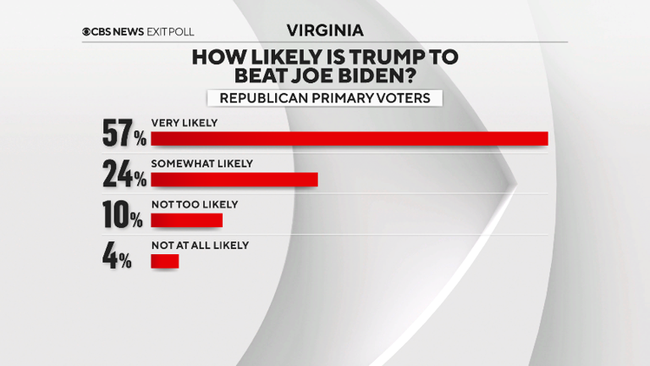
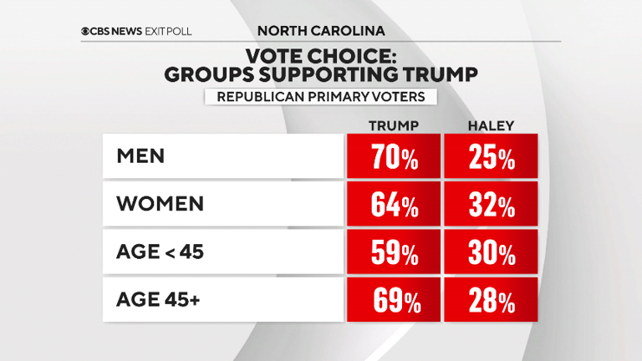
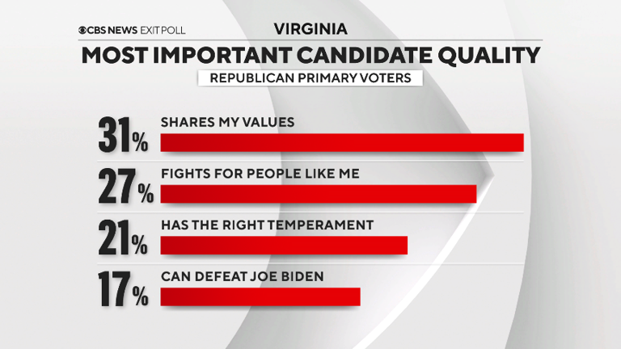
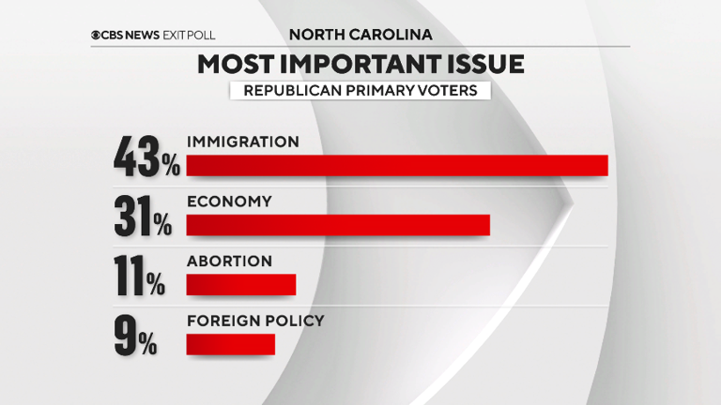
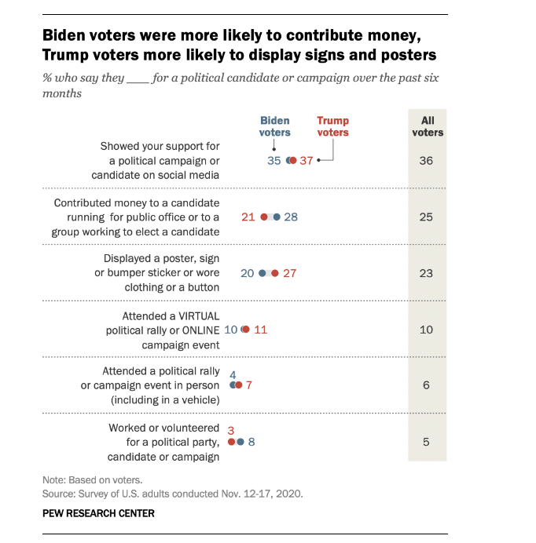
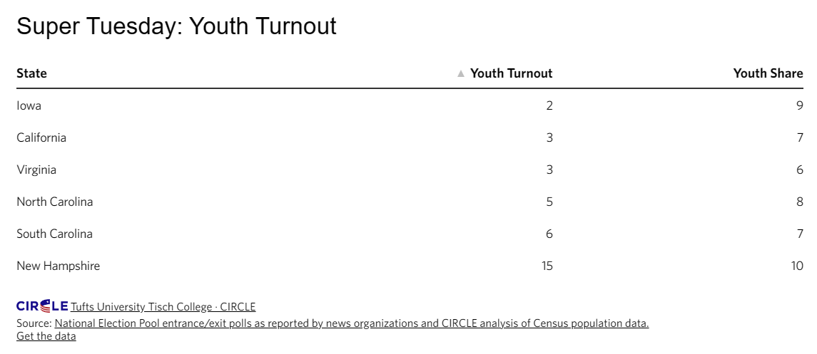
What others do?
Notes:
Super Tuesday exit polls and analysis for the 2024 primaries (msn.com)
Super Tuesday: Youth Turnout Low in North Carolina, Virginia, and California | CIRCLE (tufts.edu)
Key findings about voter engagement in the 2020 election | Pew Research Center

Slide 5
How: How we gather the data
What data we gathered, how they look like, and what is different in this data
How we organized them and why this way sample of code and output results

Slide 6
How: How we gather the data
What part of the data was complex, and how we tackle the complexity to achieve our goal, how we achieve our goal

Slide 7
Results: What results say
What we want to represent here and why to answer: What results we have chosen, what they say about the hypothesis, what our analyses on super Tuesday may say about the election, and what we present here

Slide 8
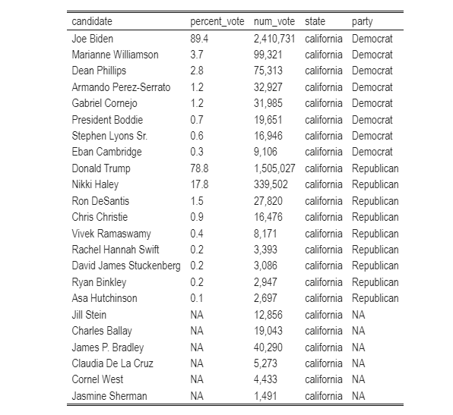
Observations and analyses
Tabulated data: The largest proportion to grab is Nikki Haley’s, who can attract them, and how? What matters to them
Only in two states of super Tuesday Democrats turn out were higher than Republicans, on the rest Republicans were decisively more

Slide 9
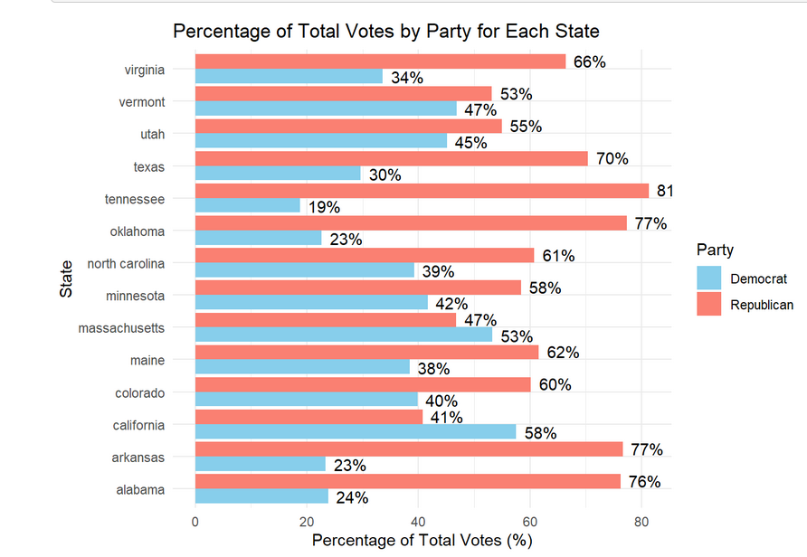
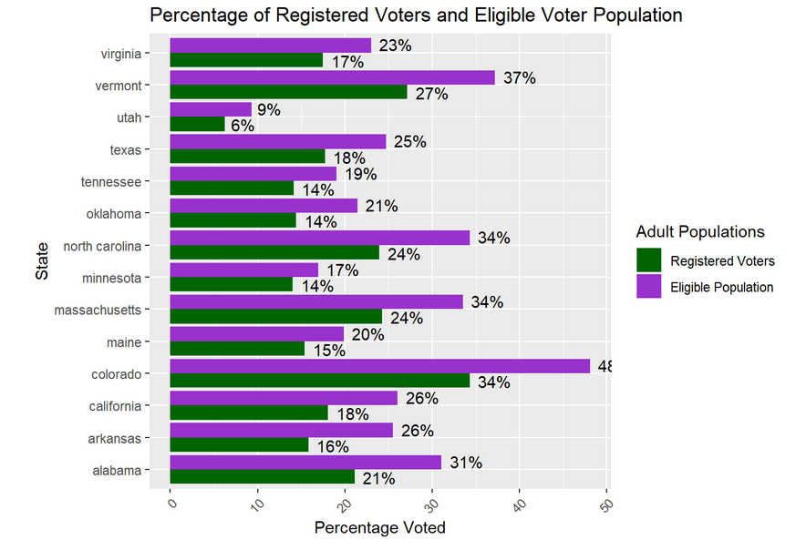
What State matters
States that voter may matter: Vermont, Utah, Massachusetts, (difference below 10%)
Registered vs total, what kind of inference we can make?

Slide 10
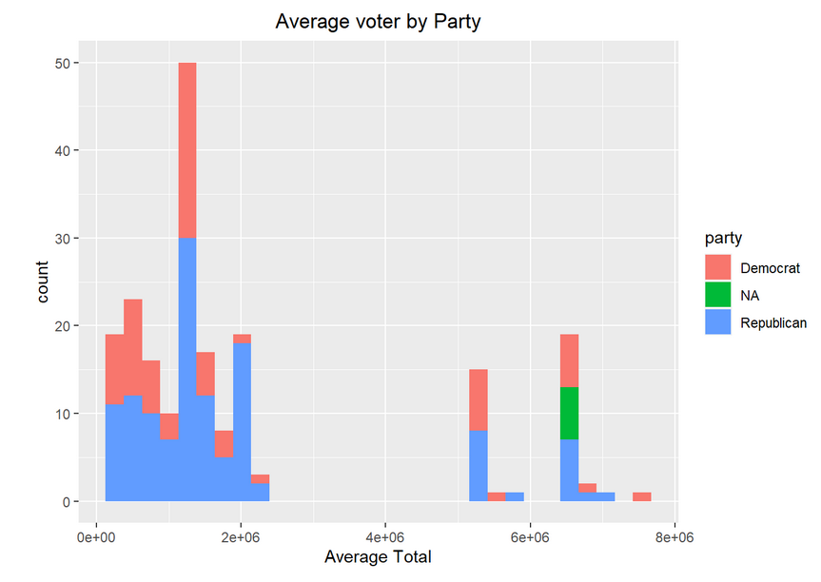
What conclusion we can make of Average voter?

Slide 11
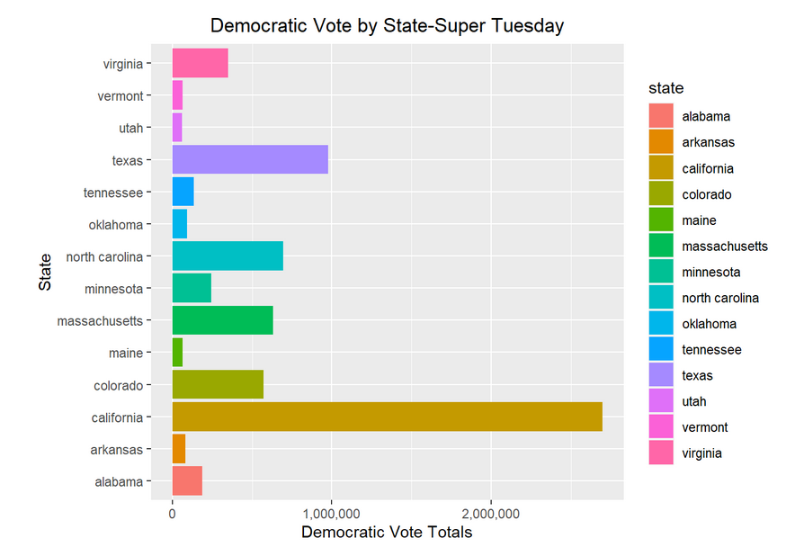
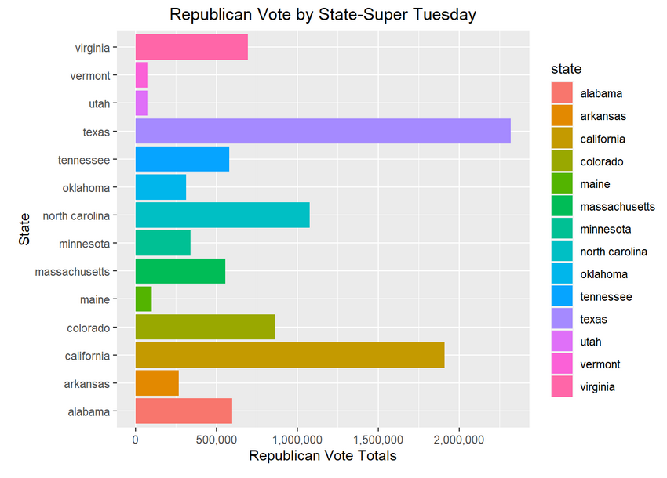
Voter Turnout – What day say about enthusiasm?

Slide 12
Lesson learned
Working in a tram requires planning and dedication, people have different interests and strengths, takes time to figure out who does what good.
Have a plan, see what others do, and learn from it to plan your analyses
Good data is available but getting them and organizing them is difficult, requires extra attention, and understanding the structure of the data
Notes:
What is our take from he project, what would we do differently, what we did well, and what we have learned

Slide 13
Source
Top 10 Data & AI Trends for 2024. From LLMs transforming the modern data… | by Barr Moses | Jan, 2024 | Medium

Slide 14
THANK YOU
Team:
Anthony C. , James N, Koohyar P., and victor T.

